Slide 1


Customer Market Segmentation
& Retention Strategies
GROUP 3

Slide 2

AGENDA
Executive Summary
Analytical Techniques
Market Segmentation
Customer Retention Strategies
1
2
3
4

Slide 3
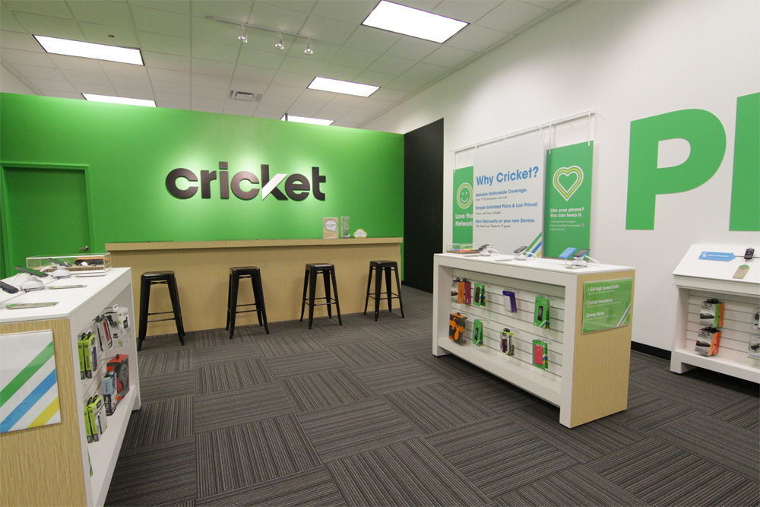
Executive Summary
About Cricket
Prepaid Wireless service provider in the US.
Whole owned subsidiary of AT&T Inc.
Founded in 1999 by Leap Wireless International Inc.
Business Objective
Identify major market segments.
Business Problem: How does cricket reduce churn and increase customer retention?
Financial Impact (+$186,678/month)
Our test plan, if implemented, results in 38% revenue growth. per month.

Slide 4
Analytical TECHNIQUES
Segmentation
Elasticity Modeling
Identify cluster’s sensitivity/insensitivity to price
Survival Analysis
Determine the segment with highest churn
Helps understand customer behaviour
Discover how change in price affects revenue
Predict a customer’s lifetime value
Insights to increase customer retention rates

Slide 5
MARKET SEGMENTATION
What customer does for a living, does it matter?
Committed Mid-level Clients
5%
Nuts & Bolts
8%
Game of Phones
Promo-loving Newbies
Talkaholics
Average Tenure: 169
9%
Average Tenure: 141
32%
Average Tenure: 179
11%
Loyal Money-savers
62% churn
35%
Average Tenure: 166
Average Tenure: 156
Average Tenure: 186
68% churn
67% churn
77% churn
65% churn
73% churn

Slide 6
MARKET SEGMENTATION
What customer does for a living, does it matter?
BIG YES!
Committed Mid-level Clients
Game of Phones
Promo-loving Newbies
Talkaholics
Loyal Money-savers
92.8% Mgmt. Jobs
100%
Office Admins
72.5% Sales Jobs
84.4% Technical Jobs
Nuts & Bolts
86.2% Blue-collar Workers
41% Others
32% Retired

Slide 7
MARKET SEGMENTATION
On a average, if we can raise customer tenure by 1 day, we can increase revenue by $1.58!

Slide 8
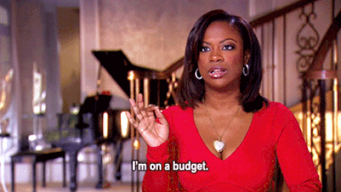
Segment 1 : Loyal Money-savers
KEY CHARECTERISTICS:
Largest Customer Segment
Sends highest # of messages
Good % of new customers
Loves bundling offers
Prefers Auto-bill pay options

Slide 9
Segment 1 : Loyal Money-savers
ELASTICITY MODELING:
Segment is INELASTIC.
Insight : This segment has the highest tenure and are insensitive to price.
Elasticity | % Plan amount | % Revenue
-0.94 | +10% | +24.21%
Increase Price
Increase Revenue

Slide 10
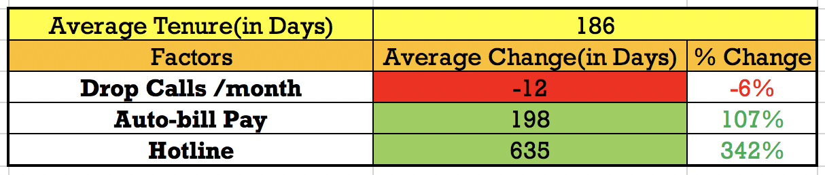
Segment 1 : Loyal Money-savers
SURVIVAL ANALYSIS:
Recommendations:
Drop Call monitoring to be increased and strategies to reduce them be initiated.
Motivating customers to opt for auto-bill payment with incentives/cashback.
Nationwide Hotline numbers to be made as default contacts for all customers.

Slide 11
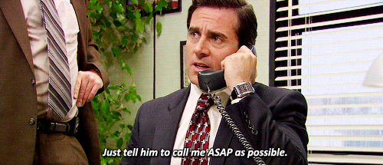
Segment 2 : Committed Mid-level Clients
KEY CHARECTERISTICS:
Smallest Customer Segment
Never uses hotline service
Doesn’t go behind bundling offers

Slide 12
Segment 2 : Committed Mid-level Clients
ELASTICITY MODELING:
Segment is ELASTIC.
Insight : These mid-level clients are purely using the services to get value for money. If we increase the price, our clients will leave, thereby decreasing revenue.
Elasticity | % Plan amount | % Revenue
2.54 | +10% | -5%
Increase Price
Decrease Revenue

Slide 13
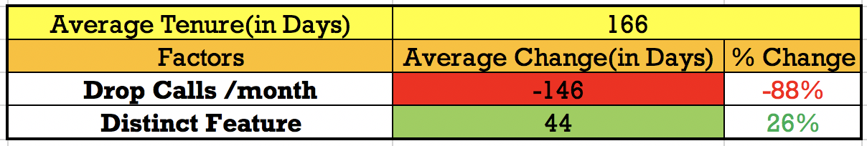
Segment 2 : Committed Mid-level Clients
SURVIVAL ANALYSIS:
Recommendations:
Drop Call monitoring to be increased and strategies to reduce them be initiated.
Introduce new features specific to the network to be introduced and enable them for the opted plans.

Slide 14
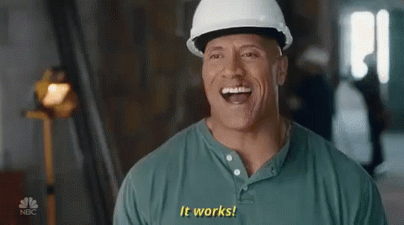
Segment 3 : Nuts & Bolts
KEY CHARECTERISTICS:
Use lots of data
Has least drop call problems
Pays by credit card

Slide 15
Segment 3 : Nuts & Bolts
ELASTICITY MODELING:
Segment is INELASTIC.
Insight : This segment is insensitive to price.
Elasticity | % Plan amount | % Revenue
0.52 | +10% | +19%
Increase Price
Increase Revenue

Slide 16
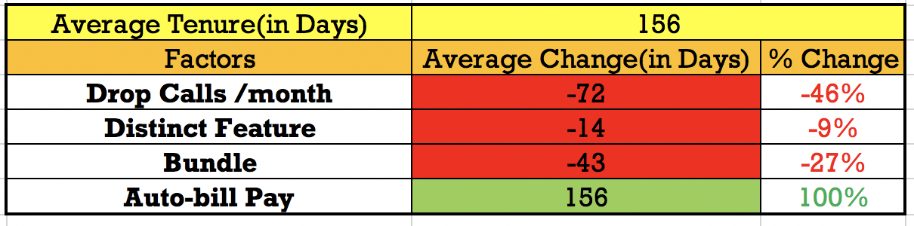
Segment 3 : Nuts & Bolts
SURVIVAL ANALYSIS:
Recommendations:
Drop Call monitoring to be increased and strategies to reduce them be initiated.
Brand new features should not be included in the plans opted by this segment.
Bundling of services should be avoided.
Motivating customers to opt for auto-bill payment with incentives/cashback.

Slide 17
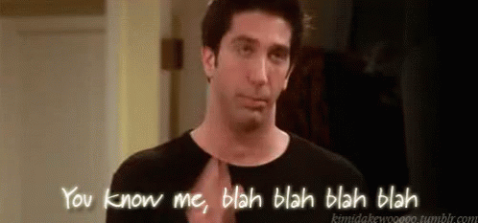
Segment 4 : Talkaholics
KEY CHARECTERISTICS:
Makes lots of customer calls
Has highest avg. duration /customer call
Loves using coupons

Slide 18
Segment 4 : Talkaholics
ELASTICITY MODELING:
Segment is ELASTIC.
Insight : Customers in this segment make a lot of calls to Integrated Voice Response(IVR). So, an increase in price will increase attrition and decrease the revenue.
Elasticity | % Plan amount | % Revenue
2.1 | +10% | -35%
Increase Price
Decrease Revenue

Slide 19
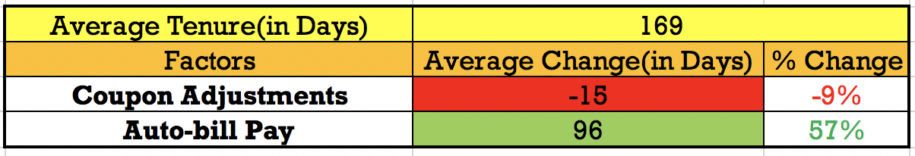
Segment 4 : Talkaholics
SURVIVAL ANALYSIS:
Recommendations:
Restricting usage of coupons for bill payment.
Motivating customers to opt for auto-bill payment with incentives/cashback.

Slide 20
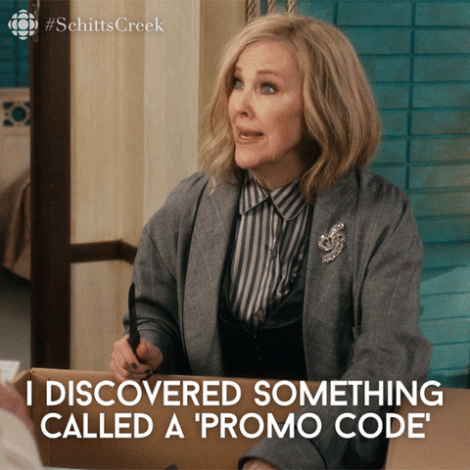
Segment 5 : Promo-loving Newbies
KEY CHARECTERISTICS:
Least tenure rate
High # of new users
Never makes customer calls
Loves Bundling of offers
Low in texts and calls

Slide 21
Segment 5 : Promo-loving Newbies
ELASTICITY MODELING:
Segment is INELASTIC.
Insight : People in this segment love the seasonal promotions and coupons. Increase/Decrease in Plan revenue amount is indifferent to this segment so they will leave irrelevant of that.
Elasticity | % Plan amount | % Revenue
0.3776 | +10% | +15%
Increase Price
Increase Revenue

Slide 22
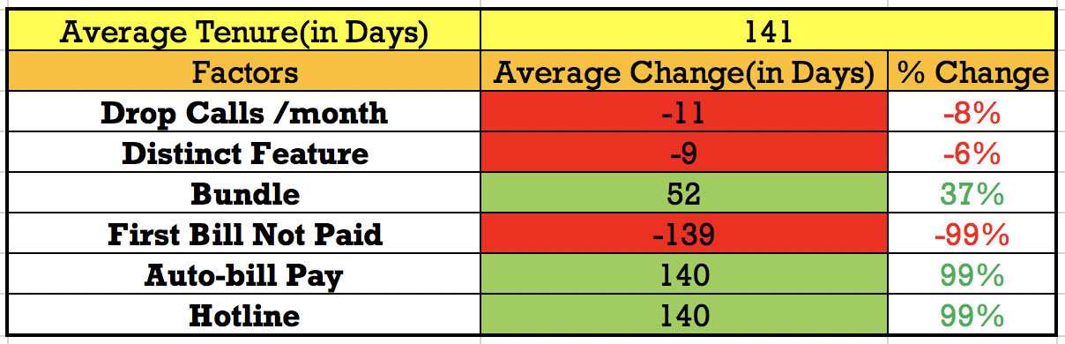
Segment 5 : Promo-loving Newbies
SURVIVAL ANALYSIS:
Recommendations:
Bundling of VoLTE calls along with unlimited data, calling and texting should be introduced for plans opted in this segment.
Incentives in the form of bundling/cashback should be introduced in order to avoid failure of 1st bill payment.
Customers enabling auto-bill payment should be rewarded through loyalty programs..
Nationwide Hotline numbers to be made as default contacts for all customers.

Slide 23
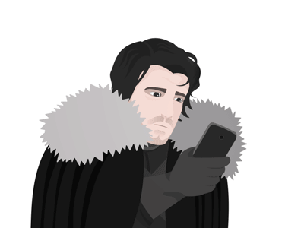
Segment 6 : Game of Phones
KEY CHARECTERISTICS:
Good tenure rate
Likes to call and talk
Highest # of drop calls
Makes lots of customer and hotline calls

Slide 24
Segment 6 : Game of Phones
ELASTICITY MODELING:
Segment is unit ELASTIC.
Insight : Segment is perfectly responsive to changes in price of plan.
Elasticity | % Plan amount | % Revenue
1 | +10% | -1%
Increase Price
Minimal change Revenue

Slide 25
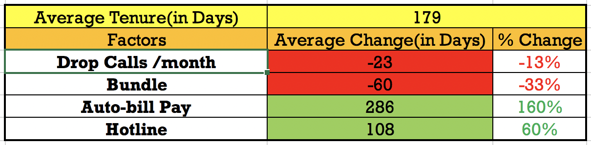
Segment 6 : Game of Phones
SURVIVAL ANALYSIS:
Recommendations:
Periodical review of Drop Calls to be done and strategies to reduce drop calls be proposed based on highly efficient forecast systems.
Motivating millennials to opt for auto-bill payment with exciting incentives/cashback.
Nationwide Hotline numbers to be made as default contacts for all customers.

Slide 26

CUSTOMER RETENTION STRATEGIES
MARKETING ACTIONABILITY:
Bundling
Increase Bundling offers by 10% to all customers.
Auto bill
Increase customers rewards such as incentives/cashbacks by 25% when they opt for auto-bill pay options.
Hotline
Target 10% usage of hotline services by creating Nationwide Hotline numbers as default contacts for all customers.
Tenure = +14 days.
Tenure =+5 days.
Tenure = +35 days.

Slide 27
FINANCIAL IMPLICATIONS:

Slide 28






THE LOYALTY REWARD PROGRAM:
TIER3 :
Qualified for a lucky draw
Referred customers enter Tier2
TRIPLE SCOOP
DOUBLE SCOOP
SINGLE SCOOP
TIER2 :
6 months auto-billing
5 new customers referred
TIER1 :
3 months auto-billing

Slide 29
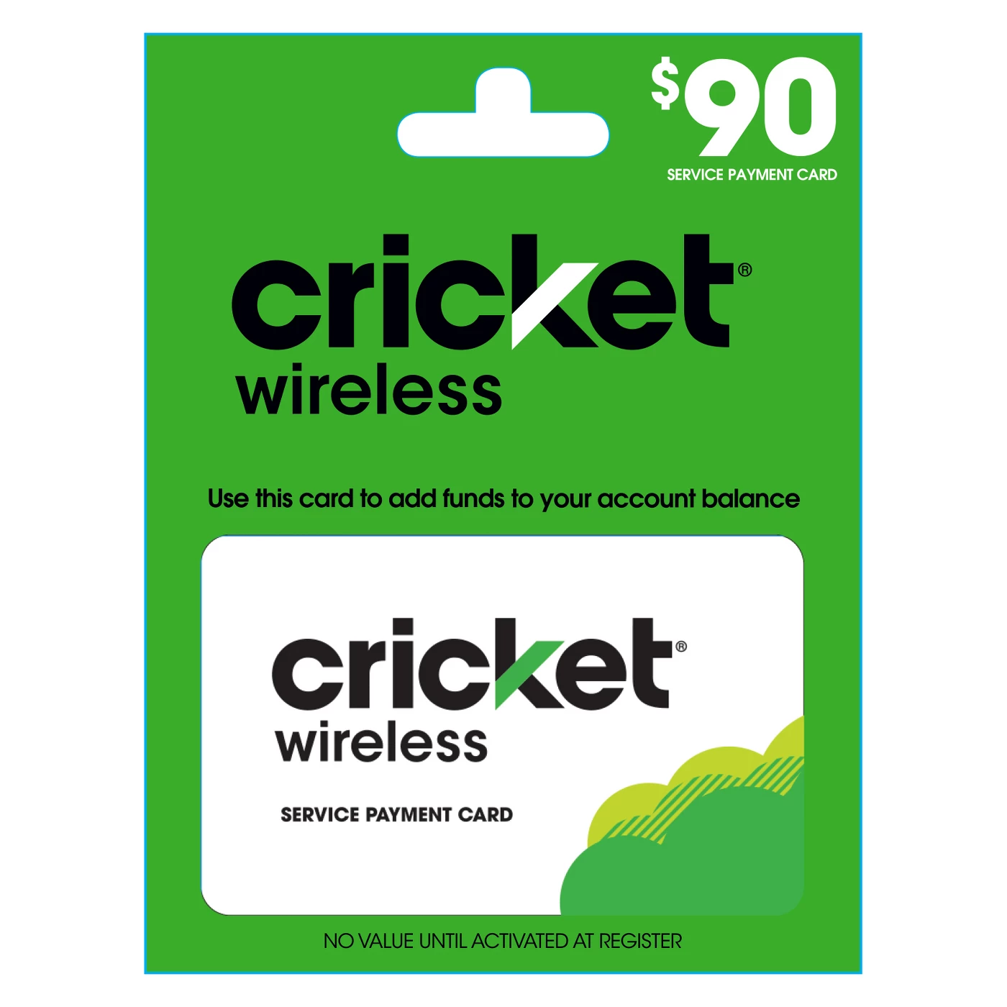
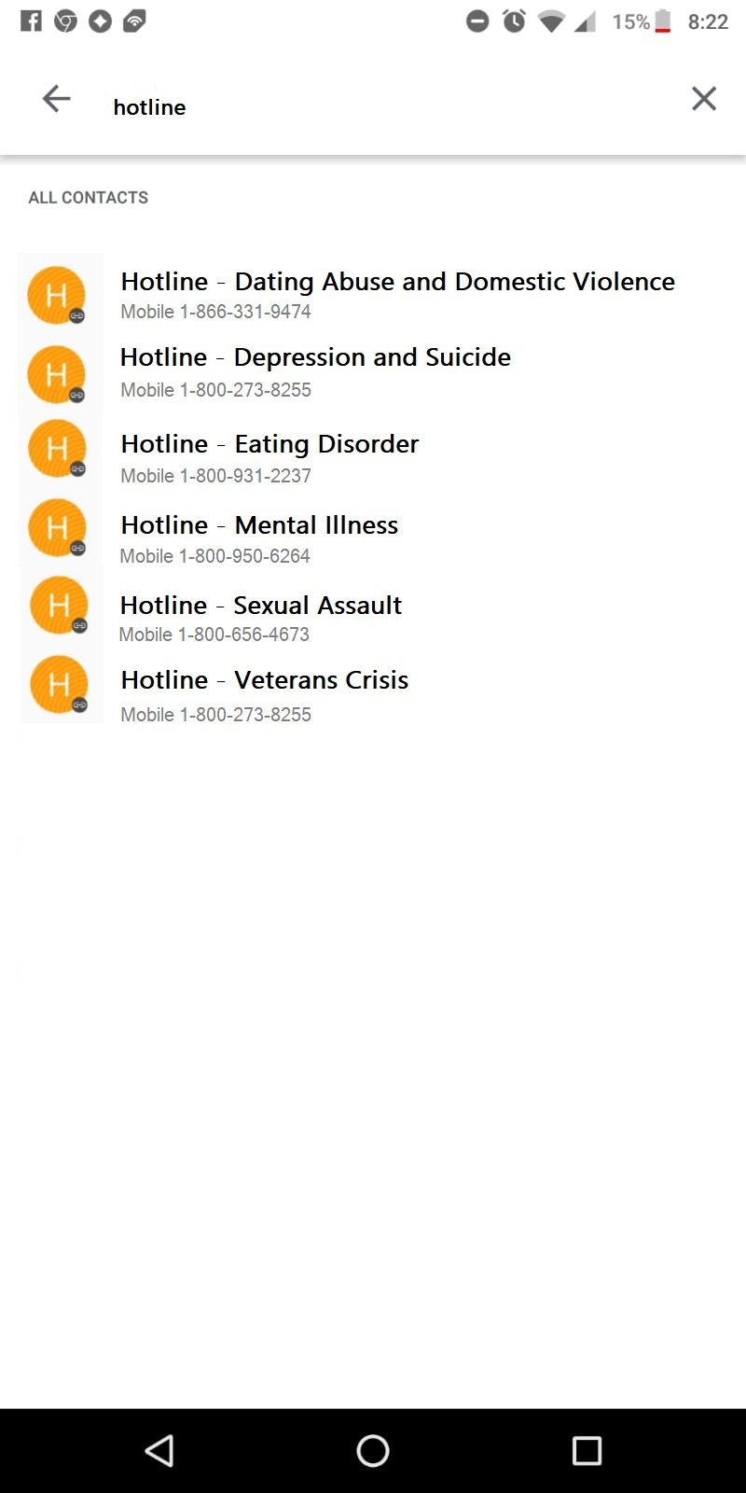

SAMPLE ADS & PROMOTIONS:

Slide 30
TEST & LEARN PLAN:
EVALUATION
Apply auto optimized, personalized plan for 25% throughout all segments
VALIDATION
Validate the potential success and expand into different target markets
CONTROL
Track and manage the brand’s progress by target market acquisition
Diagnose why some consumers are reluctant to embrace the marketing plan and develop action plans that address these barriers
DIAGNOSE

Slide 31

THANK YOU!
Mike Grigsby
Meenakshi S
Archita J
Aayushi B
Sidheswar V
Anushka P

